Slide 1

CT-351 Cloud Computing
Mr. Kamal Kant Hiran

Slide 2
Module 01
Cloud Services and Deployment Models
“If someone asks me what cloud computing is, I try not to get bogged down with definitions. I tell them that, simply put, cloud computing is a better way to run your business.”
~ Marc Benioff, Founder, CEO and Chairman of Salesforce

Slide 3
Cloud deployment models
A cloud deployment model can be described as a distinct parameterized configuration of the cloud computing environment.
Public (external) cloud
Private/Internal/Corporate cloud
Hybrid cloud
Community cloud

Slide 4
Cloud deployment models
Public (external) cloud

Slide 5
Cloud deployment models
Private/Internal/Corporate cloud:
On-premise private cloud

Slide 6
Cloud deployment models..
Private/Internal/Corporate cloud:
Out-sourced private cloud

Slide 7
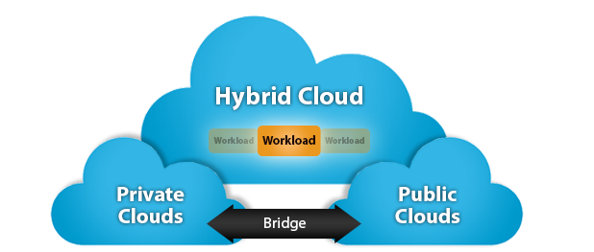
Cloud deployment models..
Hybrid cloud:

Slide 8
Cloud deployment models..
Community cloud:
Out-sourced community cloud

Slide 9
Cloud deployment models..
Community cloud:
On-site community cloud

Slide 10
Comparative Analysis..

Slide 11
Comparative Analysis

Slide 12
Cloud Service Models
There are basically three service models for a cloud computing system, namely, Infrastructure-as-a-Service, Platform-as-a-Service and Software-as-a-Service.
Infrastructure-as-a-Service (IaaS)
Platform-as-a-Service (PaaS)
Software-as-a-Service (SaaS)

Slide 13
Cloud Service Models..

Slide 14
Cloud Service Models
A summary of personnel responsibilities in cloud service models is given in below table.

Slide 15
Summary
A public cloud is also known as an external cloud. The data and application in the public cloud are created and retained on third-party servers for general public access and use.
A private cloud can also be described as an internal cloud or corporate cloud. A private cloud is a computing model where IT services are provisioned over the private IT infrastructure for the dedicated use of a single organization.
A hybrid cloud is a type of cloud computing which uses a mix of one or more private and public clouds to perform distinct functions.
A community cloud is a type of cloud computing which is shared by one or more organizations forming a group with common computing concerns.

Slide 16
Summary..
There are basically three service models for a cloud computing system, namely, Infrastructure-as-a-Service, Platform-as-a-Service and Software-as-a-Service.
Infrastructure-as-a-service (IaaS) is a service-oriented and secure enterprise - level computing infrastructure. IaaS provides hardware, storage, servers and data center space or network components. It may also include software.
Some examples of IaaS cloud include Eucalyptus, Nimbus, Amazon EC2, S3 and Rackspace. IaaS is also known as hardware-as-a-service (HaaS).
PaaS provides a platform and environment to allow developers to build applications and services over the internet.

Slide 17
Summary..
Some examples of PaaS are Apache Stratos, Microsoft Azure, IBM Bluemix, Force.com and Google Apps.
Software-as-a-Service (SaaS) allows data and applications to be accessed from any device with internet connection and a web browser. SaaS applications are sometimes called web-based software, on-demand software, or hosted software.
Some examples of SaaS hosted applications include Microsoft Office 365, Google Docs, Salesforce, NetSuite, Hotmail, Gmail, WebEx and Microsoft LiveMeeting.

Slide 18
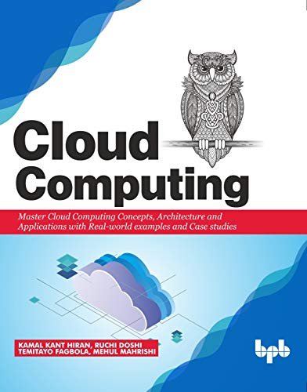

Suggested Readings
Hiran, K. K., Doshi, R., Fagbola, D. T., & Mahrishi, M. (2019). Cloud Computing: Concepts, Architecture and Applications with Real-world examples and Case studies . BPB Publications.
Erl, T., Puttini, R., & Mahmood, Z. (2013). Cloud computing: concepts, technology, & architecture. Pearson Education.

Slide 19

Any query?

